Slide 1
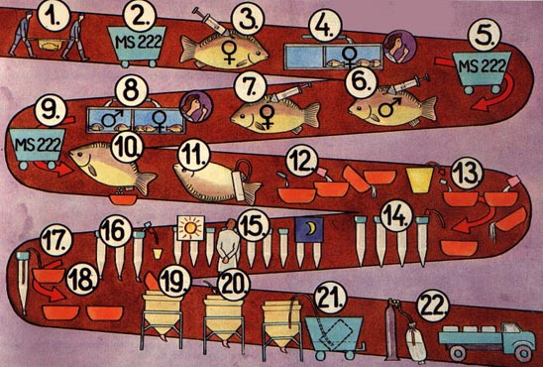
عمليات التكاثر الإصطناعي
Artificial Breeding Processe

Slide 2

Broodstock management in tropical climates
Two sets of ponds are used for the ripening males and females,
and two sets of ponds are used for the spent spawners.
This prevent wild spawning

Slide 3
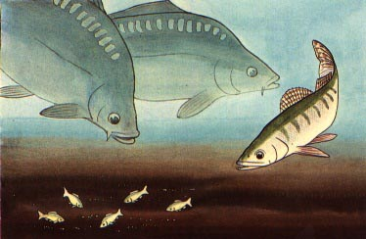
In the broodstock ponds, it is advisable to include some smaller
(100-200 g) carnivorous fish with the carp breeders
About 200-400 ind/ha is sufficient to control the wild fish which might
enter the pond and compete for food with the broodstock.

Slide 4
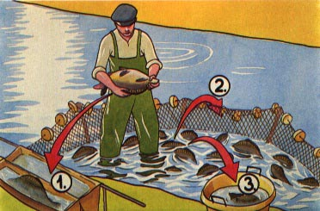
The breeders which are to be propagated artificially on a particular day,
are taken from the storage ponds the day before. They are crowded
into a corner of the half-drained pond with a seine net
Skilled worker selects the breeders one by one
1- mature breeders are brought into the hatchery building
2- immature breeders are put back into the storage pond
3- unhealthy or invalid fish are sent to the market

Slide 5
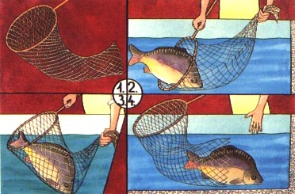
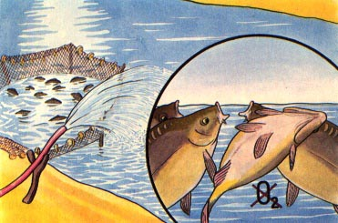
It is best to handle carp
breeders using a special
net with a strong mesh
It is important to avoid
dissolved oxygen deficiency
which may damage the
sensitive breeders during
seining and selection

Slide 6
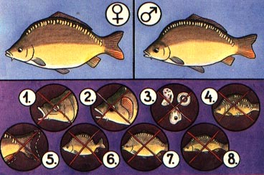
Brooders Selectionإنتخاب الأمهات
1- the selected fish
should be in good health
2- with no body wounds
3- with no parasites
4- with typical scale distribution
5&6- no fin or body deformation
7&8- The body should possess the required shape and proportions,
being neither too fat, nor too thin.

Slide 7
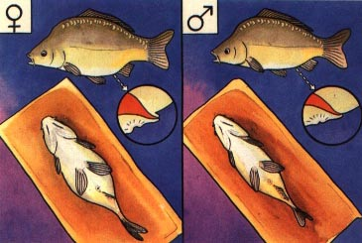
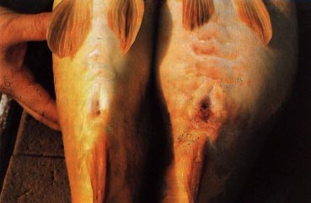
Brooders Selectionإنتخاب الأمهات
Male and female breeders may be easily differentiated by the shape
of the body and the relative position of the genital papilla.
In females, the body is plump and the genital opening is situated
above the genital papilla
In males, the body is slender and the genital opening is found
behind the genital papilla.

Slide 8
Anaesthetic Process
Three chemicals may be used as fish anaesthetics
1- MS 222 or tricaine methane-sulphonate is a very mild
and safeanaesthetic from which fish easily recover. Fish may
be kept in it for about 30 minutes at 20-25°C. it is rather
expensive and must be used sparingly
MS 222 1:10000 or 10 g dissolved in 100 L. water

Slide 9
2- Quinaldine or 2-4 methylquinolin is a toxic chemical which
should be handled with great care and stored safely. During
the treatment of the fish, they should be carefully
watched and transferred quickly to well
oxygenated water if necessary
Quinaldine 1:40000 or 2.5 ml dissolved in 100 L. water
3- Phenoxyethanol is milder and less effective than
MS 222 but is far cheaper
Phenoxyethanol 1: 5 000 or 200 ml dissolved in 100 L. water

Slide 10
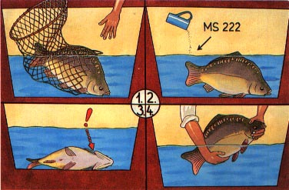
When the selected female breeders are brought into the hatchery early in the
morning, they are placed in a small tank containing 100 litters of water
They are anaesthetized, using for example MS 222,
From now on the anaesthetized breeders should be watched carefully to see if
their opercules keep moving. The life of the fish is in danger when this movement
stops. In this event the breeder should be immediately removed from the
anaesthetic solution and put into well-aerated fresh water

Slide 11
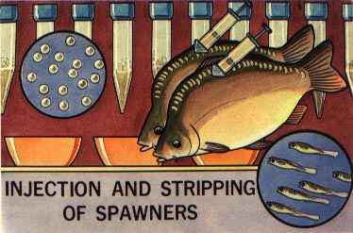
The advanced technique of the artificial propagation of common carp involves a
hormonal treatment prior to hand stripping of the mature
spawners to obtain sperm and eggs
Females (First injection: 0.3 mg/kg, Second injection: 3.5 mg/kg)
Males (one injection only: 2.0 mg/kg(

Slide 12
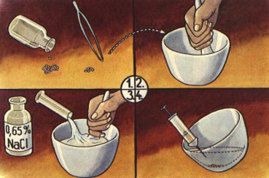
Injections of gonadotropin hormones induce the final ripening of the
dormant eggs in the selected females
The gonadotropin hormones to be injected in the breeders are
extracted from dried hypophyses

Slide 13
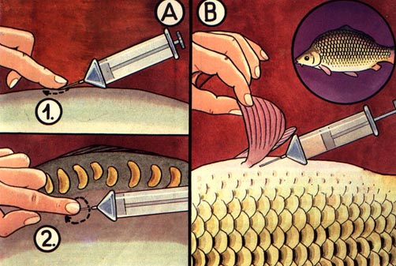
For mirror carps, the injection is intramuscular. It is generally given in the
Muscles below the tip of the dorsal fin, at a 45' angle. To avoid losing some
of the injected solution, a finger should be kept on the punctured
skin which should be slowly massaged
(B) For scaly carps, the injection is intraperitoneal. It is generally given
into the body cavity from behind the base of the abdominal fin

Slide 14
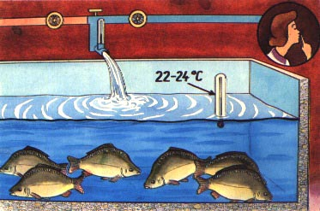

After being injected, the females are placed in a large tank
A plentiful supply of well-aerated water should be
provided. The water temperature should be kept constant, if possible
Within the optimum spawning temperature range of 22°C-24°C. To
reduce stress, the females should be kept in a quiet environment and
left undisturbed for 10-12 hours

Slide 15
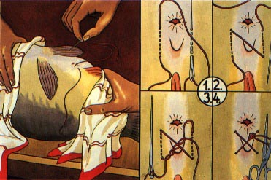
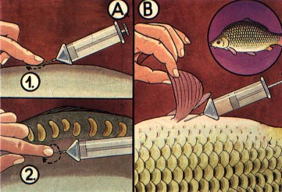
Afte10-12-hour the females are anaesthetized for the suture of
their genital opening and for the second injection of gonadotropins

Slide 16
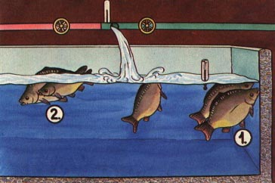
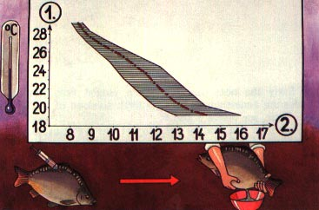
The injected females are put back into the large tank, supplied with warm
and well-aerated water
The length of the ovulation period is closely related to the water temperature

Slide 17
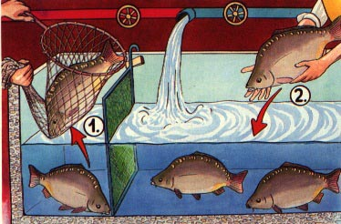
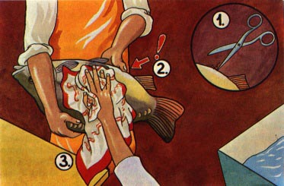
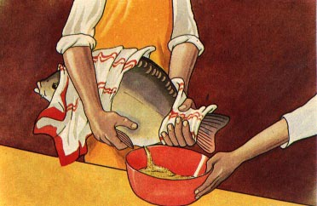
When the females are fully ripe, they are crowded into one end of the
tank with a sliding net frame.T hey can then easily be removed
individually, for anaesthetizing and stripping

